Slide 1
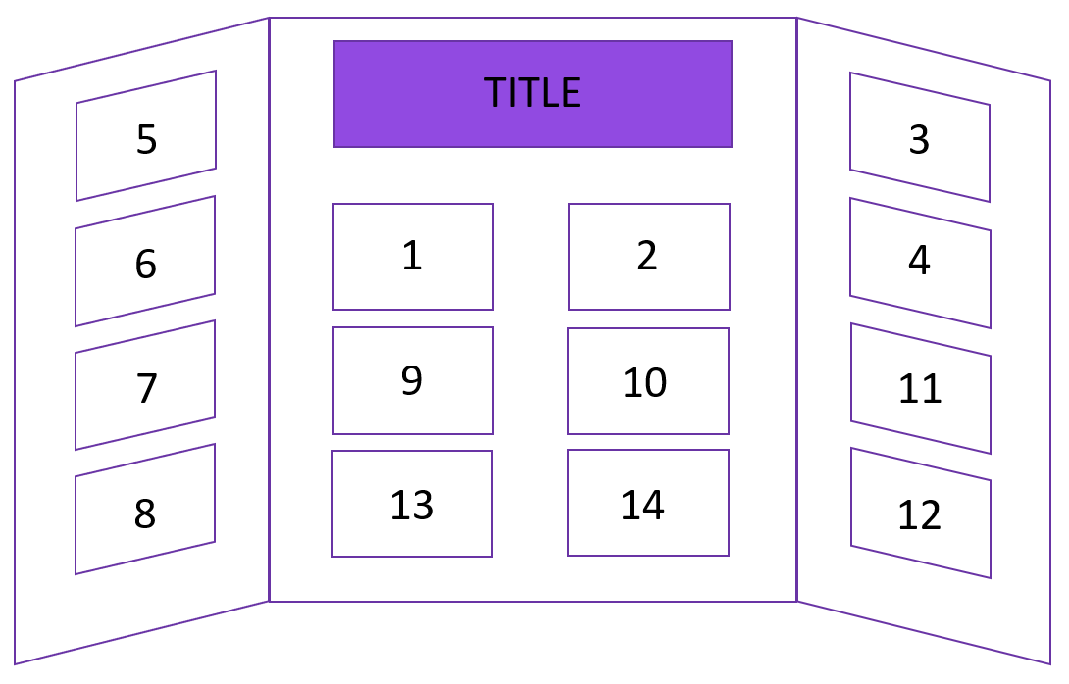
[Delete this slide when you’re finished]
Trifold board are typically 36 inches tall by 48 inches wide, with a 12-inch panel on either side and a 24-inch panel in the middle. You can fit 14 sheets of 8.5”x11” paper on it, plus space for your title.
This is just a suggestion of where things could go – your board doesn’t have to look like this! We strongly recommend making your takeaway statement (1) and hero image (2) big and on the middle panel , but beyond that, it’s up to you! Change the colours/background images of the following slides and make this project your own!

Slide 2
Big takeaway statement (1)
Teach people the main thing you want them to remember from your project in
5 seconds as they walk by.
(This is different than your title.)

Slide 3
Hero image (2)
Use a large image here that captures what you did in your project.

Slide 4

Why? (3)
Tell us your story!
250 words, plus images

Slide 5
Why? (4)
Continue your story

Slide 6
How? (5)
How did you perform your experiment or develop your solution?
300 words, plus images

Slide 7
How? (6)
Continue how you did your experiment or developed your solution.

Slide 8
How? (7)
Continue how you did your experiment or developed your solution.

Slide 9
How? (8)
Continue how you did your experiment or developed your solution.

Slide 10
What? (9)
Tell us your results! What did you find out?
500 words, plus images

Slide 11
What? (10)
Continue to share your results. What did you find out?

Slide 12
So What? (11)
Tell us why your results are important and what they mean.
250 words, plus images

Slide 13
So What? (12)
Continue why your results are important and what they mean.

Slide 14
What’s next? (13)
Tell us how you could extend your project.
100 words, plus images

Slide 15
Thank you and References (13)
Give thanks to people who supported you in your project. Tell us where you got your ideas, information and images.
You can use a very small font on this slide – this information is important, but doesn’t need to take up much room. You could also use this slide for something else, and put your thank you and references along the bottom of your project display.

